Slide 1
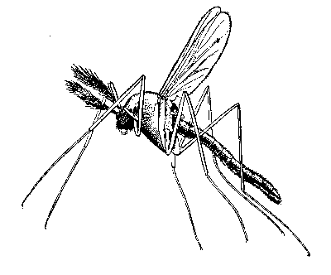
Chikungunya Virus
Alphavirus genera in
Togaviridae family
Envelope
11 kb ss+sense RNA genome
Arboviruses—mosquito
    New World Old World
VEE, EEE, WEE
Febrile and neurological disease in humans and horses
Sindbis, Ross River, Chikungunya viruses
Arthritis, arthralgia, myalgia, rash

Slide 2
Arthritic Alphaviruses
  O’nyong-nyong
    1959 African epidemic >2 million cases
    Re-emerged in 1996
    Anopheles mosquitoes
  Ross River virus
    Australian
    1979 epidemic in South Pacific
  CHIKV
    Indian Ocean outbreak >6 million cases
    Caribbean Outbreak 2013-Present > 1.2 million cases
    Ongoing South Pacific Outbreak
    Endemic Chikungunya
      Congo: 2004 (re-emergence after 39 years)
      Malaysia: 2007 (re-emergence after 7 years)

Slide 3
Chikungunya Virus
Chikungunya = Kimakonde language, meaning ”that which bends up"
Disease:
  Fever, arthralgia, headache, muscle pain, joint swelling, or rash
  Acute arthralgia can be incapacitating
  Persistent arthralgia
    10-60% of patients report chronic joint pain lasting > 1 month (up to 2 years)
    Can be relapsing
    Higher incidence in persons > 50 years old
  Complicated CHIKV disease
    Neonates (maternally acquired)
      Encephalitis
    Elderly
No approved antiviral drugs or vaccines

Slide 4

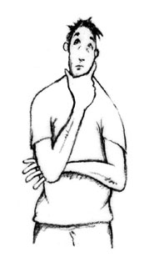
Chikungunya Virus
  Mosquito Vectors (Ae. Aegypti , Ae. Albopictus)
    broadly distributed
    Urban Epidemic transmission cycles
1965-1990s: large epidemics in India and Southeast Asia
Mid 2000’s: Large scale epidemics in Indian Ocean region and Southeast Asia
2013: Western Hemisphere
Ae. Aegypti, Ae. albopictus
Ae. Aegypti, Ae. albopictus
Urban Cycle

Slide 5
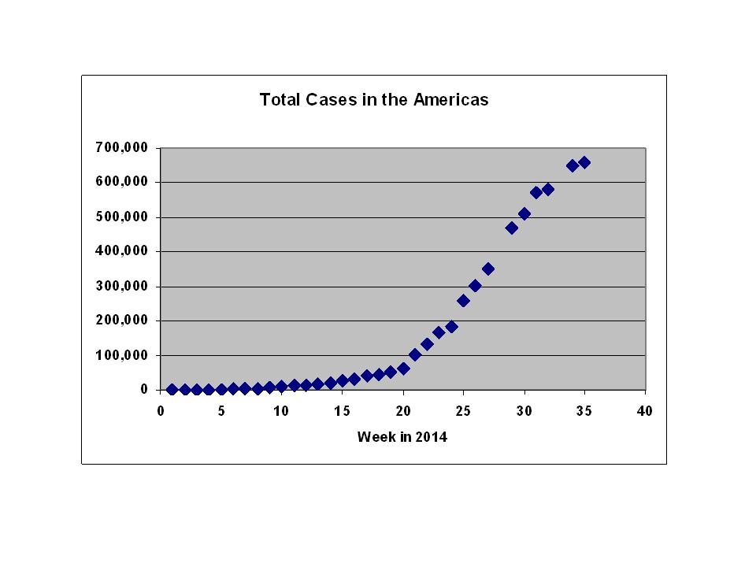
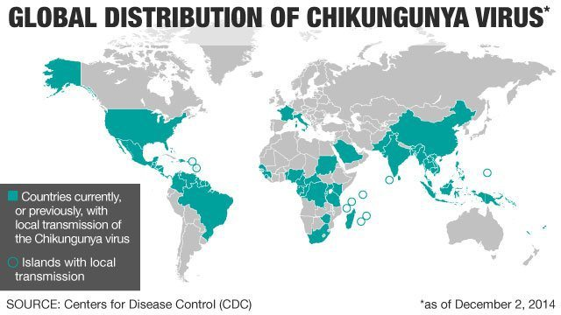


Arrival of CHIKV in the Americas
Current estimate >1 million
Joel Peralta
Lindsay Lohan

Slide 6
Where is CHIKV a Problem Now?
Ongoing transmission in South/Central America
Significant ongoing disease (neurologic and ocular manifestations in India
Major outbreak in Pakistan/Central Asia
Ongoing local transmission in Italy

Slide 7
Chikungunya and Human Disease
Human Disease
  Chikungunya: That which bends up.
  Severe arthritis/arthralgia/myalgia
    High fever (103-104 F)
    Rash
    Hemorrhagic manifestations have been reported

Slide 8
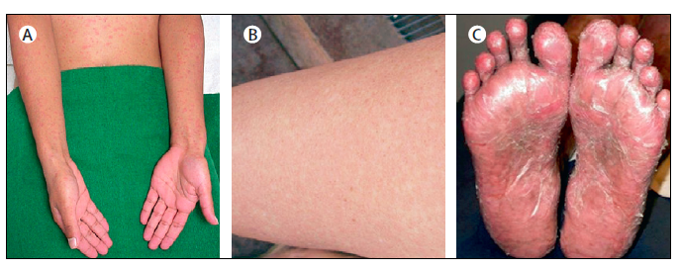
Chikungunya and Human Disease
Human Disease
  Chikungunya: That which bends up.
  Severe arthritis/arthralgia/myalgia
    High fever (103-104 F)
    Rash
    Hemorrhagic manifestations have been reported
Burt, et al., Lancet 2014

Slide 9
Chikungunya and Human Disease
Human Disease
  Chikungunya: That which bends up.
  Severe arthritis/arthralgia/myalgia
    High fever (103-104 F)
    Rash
    Hemorrhagic manifestations have been reported
    Severe incapacitating arthritis/arthralgia.
      Generalized
      Usually acute (20-60% of individuals have long-term joint complaints)
      Chronic disease more common in the elderly
    Rarely if ever fatal
  Apparent-to-inapparent infection ratio varies from 1:3 to 1:50 for CHIK and related viruses
  Infected individuals develop a high titer viremia

Slide 10
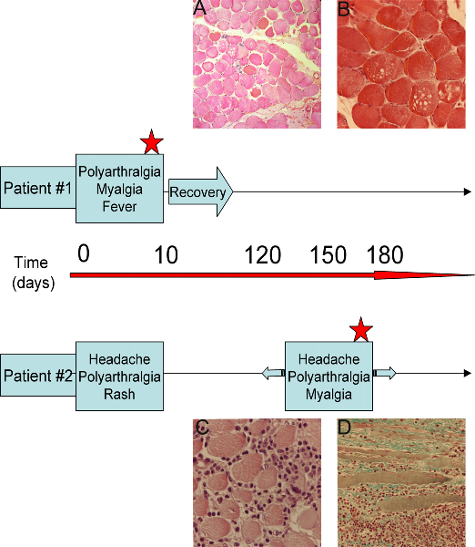
Arthritic Alphaviruses as a Global Emerging Disease Threat
▪ Clinical symptoms
Classical CHIK/RRV/ONN
▪ fever, chills, weight loss, rash
▪ arthralgia and myalgia
▪ rarely fatal
▪ persistent disease in up to 60%
- more common in the elderly
- viral persistence suspected
Severe/Complicated CHIK
▪ Multi-Organ Failure (elderly)?
▪ meningoencephalitis (neonates/maternal transmission)
▪ Disease characteristics (Classical)
▪ monocytic inflammation of synovium and muscle
▪ swelling of joints
▪ CHIKV antigen detected in skeletal muscle satellite cells
▪ Persistent inflammation and viral antigen in joints of chronic patients
Quadriceps muscle
Ozden et al., 2007. PLoS One 2(6)
Notes:
In addition to causing endemic disease, this group of viruses is capable of causing explosive epidemics including a 1959-1962 epidemic of Onyong virus infection that resulted in over 2 million cases, a 1979-1980 epidemic of Ross river virus infection in the south pacific that resulted in over 50000 cases and an ongoing epidemic of Chikungunya virus infection that began on the coast of kenya, and spread to islands in the Indian ocean, India, and Sri Lanka and has resulted in at least 6 million total cases. This epidemic potential highlights the need to better understand the pathogenesis of these viruses and to develop new therapeutics
Infection with these viruses results in a similar disease in humans that is characterized by debilitating joint and muscle pain that can last for weeks to months. The disease has mostly been studied in the context of Ross river virus infection and studies have shown that the disease is characterized by inflammation of the synovium composed primarily of monocytes and macrophages as well as some lymphocytes and NK cells. In addition, RRV antigen and RNA has been detected in the synovium. These findings suggest that initiation of this disease is due to direct viral replication within in the affected tissues.
More recently, both CHIKV antigen and monocytic inflammation has been detected in quadriceps muscle biopsies collected from CHIKV-infected patients. Together, these findings suggest that infection of humans with these viruses results in both arthritis and myositis
In terms of human disease, Ross river virus infection is the best understood. Ross River virus is the cause epidemic polyarthritis. Which is the most common arboviral disease in Australia.
People experiencing Ross River virus disease primarily have debilitating joint and muscle pain, that can last anywhere from weeks to months. The disease is characterized by inflammation of the synovium, consisting primarily of monocytes and lymphocytes. In addition, RRV antigen has been detected in synovial macrphoages and viral RNA has also been detected in synovium. However, intact virus has not been direclty isolated from the joints of infected humans.
NOTES:
Wrists, knees, ankle, hands most common joints affected
Rheumatoid has neutophilic infiltrate and TNF plays major role
Clinically apparent infections are rare in children , most common among adults age 25-40.
Synovium: thin layer of tissue that lines the joint space.

Slide 11
Its Rarely Lethal, so Why Worry About It?
Massive outbreaks in susceptible populations
  1/3 of the population of Reunion Island
  Several Million cases in India
  Hundreds of thousands of cases in Dominican Republic
Severe acute and sometimes chronic joint pain
  Incapacitating
  Impact on public health system
Represents a model for other emerging viral pathogens
  Yellow Fever
  Dengue

Slide 12
How Does CHIK Cause Disease?
Direct virus-induced damage?
  Virus is very cytopathic in cell culture
  Rapid disease onset following infection suggests that adaptive immunity is not involved
Host Response?
  Highly inflammatory
    Myositis
    Arthritis
    Swelling
  NSAIDs help

Slide 13
What Can Animal Models Tell Us?
Difficult to evaluate mechanisms of disease in humans
  Rarely lethal
  Joint tissues difficult to assess
Mouse Models
  Sites of viral replication/Pathology
  Mechanisms of Protection/Disease
    Viral Determinants
    Host Factors
  Early stage vaccine/therapy testing
Non-human primates
  Sites of replication/Pathology
  Advanced vaccine/therapy evaluation

Slide 14
Determinants of Pathogenesis
(What Causes Disease?)
  Viral factors (?)
  Host factors
    Protective
      Type I interferon
      Antibody
      T cells
    Pathologic
      T cells
      Overactive inflammatory response

Slide 15
What Factors are Driving CHIK Emergence?
Host Factors
  Immunity
  Host genetics?
Host Behavior
  Travel
  Lifestyle
Vector
  Vector distribution
  Viral changes

Slide 16
Treatments/Vaccines
No Approved Virus Specific Therapies
  NSAIDs
  Monoclonal antibody trials (pregnancy)
Vaccines (none approved)
  Live attenuated vaccine (181/25) failed in clinical trials due to adverse events
  Modified live attenuated vaccine and measles based vectors vaccines in clinical trials

Slide 17
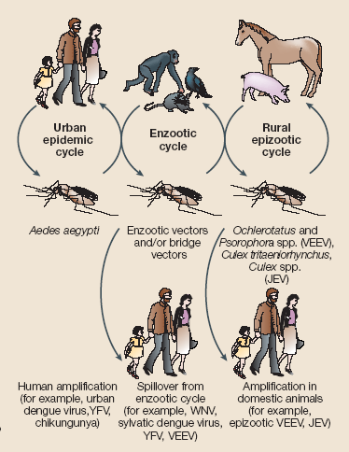
Arboviral Emergence
Weaver and Barrett, Nat Rev Microbiol. 2004.
Notes:
The reservoir hosts of most alphaviruses are typically small rodents or birds. Enzootic subtypes of VEE are maintained in permanent sylvatic cycles, and normally go unnoticed. However, if people set foot in these habitats, these subtypes can cause fatal disease. More commonly human disease is associated with epizootic epidemics. Like WEE and EEE, VEE can infect horses and cause disease. However, only VEE achieves high enough serum titers to enable efficient transmission to biting mosquitos. This can result in massive equine outbreaks that also affect humans since horses serve as efficient amplification hosts that are in closer association to human populations. In the case of EEE and WEE, horses are dead-end hosts just like humans.

Slide 18
Chikungunya Transmission
The Basics:
Rural cycle
  Ae. Africanus and Ae. Furcifer maintenance with wild primates
Urban cycle
  Ae. Aegypti
  Ae. Albopictus
Ae. Aegypti, Ae. albopictus
Ae. Aegypti, Ae. albopictus
Urban Cycle

Slide 19
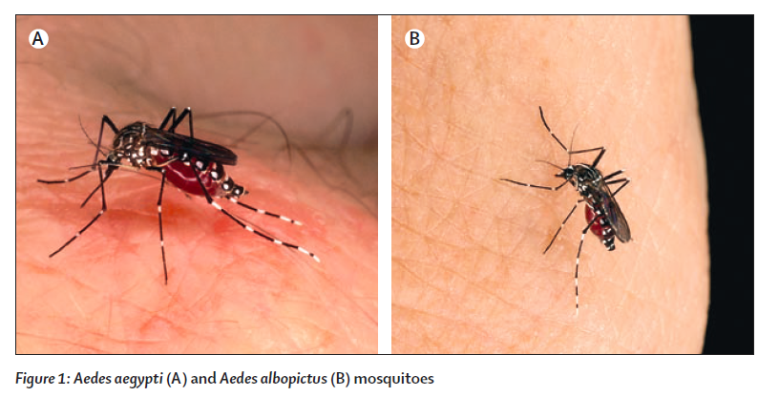
Chikungunya Transmission
The Basics:
Rural cycle
  Ae. Africanus and Ae. Furcifer maintenance with wild primates
Urban cycle
  Ae. Aegypti
  Ae. Albopictus
Ae. Aegypti, Ae. albopictus
Ae. Aegypti, Ae. albopictus
Urban Cycle

Slide 20
Viral Mutations Associated with Expanded Vector Range
Ae. aegypti is primary vector during urban epidemic cycle
Ae. albopictus appeared to be major vector during Reunion Island outbreak.
A single mutation in the viral E1 gene (A226V).
  (Tsetsarkin, et al., PLoS Pathogens 3:1895-1906)
    Increases CHIK infectivity in Ae. Albopictus
    May affect cholesterol dependence
      Fusion?
      Viral Budding
Asian CHIKV Genotype may be constrained for adaptation of Ae. Albopictus
  (Tsetsarkin, et al., PNAS, 2011, 108:7872-7877

Slide 21
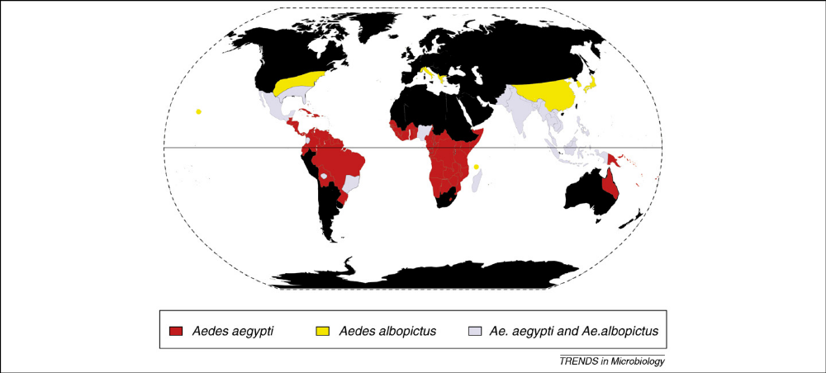
Chevillon, et al.

Slide 22

Do We Need to Worry About CHIK in the U.S.?

Slide 23
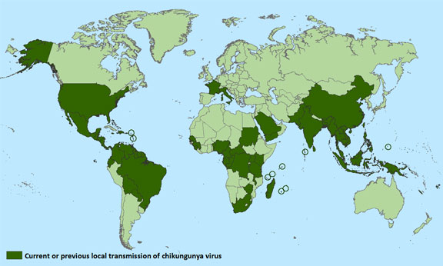
Worldwide Distribution of CHIKV
U.S. CDC Sept. 2015

Slide 24
Do We Need to Worry About CHIK in the U.S.?
Sporadic outbreaks
  Returning Travelers
  Potential for localized spread
Large Scale Epidemic?
  Risk in areas with competent mosquito vectors
    Asian CHIKV Genotype may be constrained for adaptation of Ae. Albopictus (Tsetsarkin, et al., PNAS, 2011, 108:7872-7877). This would limit spread to Ae. Aegypti.
  Possibility of endemic status?
  Dengue and YFV as examples (Reiter, et al., Emerging Infectious Diseases 9:86-89)

Slide 25
Chevillon, et al.

Slide 26
Do We Need to Worry About CHIK in the U.S.?
Sporadic outbreaks
  Returning Travelers
  Potential for localized spread
Large Scale Epidemic?
  Risk in areas with competent mosquito vectors
    Asian CHIKV Genotype may be constrained for adaptation of Ae. Albopictus (Tsetsarkin, et al., PNAS, 2011, 108:7872-7877). This would limit spread to Ae. Aegypti.

